Slide 1
NSTec Jan 2014

Slide 2
Introducing Source Code Control
Source Code Control is a tool used to track, store, and manage all files related to an application during development.
code checked in
code checked out
dev 1
dev 2
Central Code Repository
dev 3
dev 4
code checked out
code checked in
Notes:
The main idea behind SCC is that of a central code repository. This is typically a networked location where an application’s code base is stored. As contributors make changes to the code base, they can “check out” sections of code from the repository while they make edits, and then “check in” a newer version of that code when they are finished. SCC can be configured in a variety of different ways, for example, some may choose to lock the code when someone has indicated they intend to modify it. Others may allow multiple users to have it checked out simultaneously.
The most important benefit of source code control is that a revision history of the code base is stored, keeping a managed set of back-up code without creating copies of VIs on your local machine. SCC also encourages contributors to keep a diligent change log of each change that is made to the code base.
If it becomes necessary to combine changes made by developers to the same piece of code, SCC use merge tools to merge multiple versions of code in the repository. Similarly, diff tools can be used to pinpoint changes in source code between multiple revisions of a file in the repository. We will see how LabVIEW Diff and Merge tools can be configured for use with SCC.
[transition] So, what does using SCC mean for your application?
This is an illustration of how source code control improved the development process, in particular, for team-based projects. Instead of just copying code, developers now use source code control to check it out. This is effectively a developer’s method for information a higher authority (in this case, the SCC provider) that they have an intent to modify the source code.
At this point, the behavior and limitations of the SCC interface are setup at the discretion of an administrator. Some may choose, for example, to lock the code when someone has indicated they choose to modify. Others may allow multiple users to have it checked out simultaneously.
If it becomes necessary to combine changes made by developers to the same piece of code, SCC can help with merging by allowing the two copies of the file to exist in the repository. Additionally, merge is available via the command line, so the automated LVMerge functionality can be invoked in the same manner as many text based merge applications.

Slide 3
Why Use Source Code Control?
Increase productivity by allowing multiple developers to contribute in a controlled environment
Avoid code loss from overwriting
Manage files throughout the development cycle
Code revision history let’s developers track bugs quickly & document changes
Speed development with merge and diff tools
Source Code Control is a best practice for any modern software development project, regardless of complexity or team size.
LabVIEW Best Practice
Notes:
A rite of passage for any developer is making that one seemingly benign code change only to find out that it has completely paralyzed your application and oh, you can’t remember exactly how the previous working version was laid out. This has happened to us all at some point – until we saw the light and started using SCC with every application. For me, SCC has become an invaluable tool for everything I develop on my machine.
If you are working on a team with multiple developers, limiting how code is checked out of the repository can prevent two developers from overwriting each other’s work (a very frustrating experience). When things do go sideways during development and a severe bug pops up out of nowhere, tracking the bug’s first appearance becomes easy because you have an entire code revision history with documented changes at your fingertips. Finally, there are some great tools to make the process of merging pieces of code together, or finding out what has changed in the source code between two revisions.
[transition] Hopefully any non-believers out there are starting to ask yourselves how do I start using this tool for my LabVIEW development?

Slide 4
What Tools Are Available?
Recommended
Additional Options
Perforce
Subversion
(Git, Hg)
Microsoft Visual Source Safe
Microsoft Team Foundation Server Rational ClearCase
PCVS (Serena) Version Manager
MKS Source Integrity
Seapine Surround SCM
Borland StarTeam
Telelogic Synergy
Notes:
There are a wide range of SCC providers out there, and the good news is that many of them can be used with LabVIEW. For many people, the provider you choose will likely be the provider your company has standardized on.
I’ve recommended Perforce and Subversion. These are two very common providers, and many LabVIEW programmers have worked with them. Internally at National Instruments, our developers use Perforce for LabVIEW development, and as a result it’s very well tested. Similarly, many users in the LabVIEW community have been successful with Subversion, which is an Open Source option. Personally, I use Subversion for my LabVIEW development.
Again, you are welcome to use any provider that you feel comfortable with. Perforce and Subversion are simply some well tested options, but you are by no means limited to these two.
[transition] So, you’re all ready to get back to work, set up your favourite provider, and get to work developing. The next thing to consider is what files should even be kept under SCC?

Slide 5
What Files Should I Put Under SCC?
VIs
Documentation
Track revisions to a Requirements Document with SCC
Configuration Files
Type Definitions
What about the *.lvproj file itself?
Notes:
Most components of your application can benefit from SCC. Obviously, your VI source code is a great candidate and should certainly be included. Another great item to track via SCC is documentation. As your project requirements and documentation are changed, these revisions should be kept and logged for future reference. Additionally, any configuration files, type definitions, or custom controls can be kept under SCC.
[transition] An interesting file to consider is the actual *.lvproj file itself. What happens if this file is placed under SCC?

Slide 6
Should I Put My *.lvproj File Under SCC Too?
A LabVIEW *.lvproj file is an XML file that contains:
Links to files contained in the project
Settings for the project
“Virtual items” such as build specifications
It’s critical that all developers have the most recent version of the *.lvproj file to ensure they have all of the latest dependencies and resources
Notes:
Recall earlier we discussed that a .lvproj file is actually just an XML file that contains a set of links to items included in the project, as well as project settings and build specifications. As a result, it’s important that all developers have the most recent version of this file to ensure that the correct resources are being linked to.

Slide 7

Should I Put My *.lvproj File Under SCC Too?
Anytime a file in the project is renamed or added, the *.lvproj file is altered and must be checked out of source code control, impacting all developers using the project
.lvlib files are represented in the Project File by library name only. As long as the name of the library remains the same, the contents of the library can change without modifying the .lvproj file.
Individual VIs are also represented by name in a project. This means that anytime a new VI is added or removed from the project, the .lvproj file is modified.
Notes:
Anytime the set of links that a project tracks changes, the .lvproj file itself is altered. This means that if a VI is added, removed, or renamed in the project that XML file itself is altered. Anytime a project setting or build specification is changed, the XML file is also changed.
From this XML snippet of a .lvproj file, you can see that Project Libraries, those .lvlib files, are only identified by their name. These Project Libraries may include hundreds of VIs each, but they are only identified by the library name in the project.
On the other hand, if a project contains single VIs, each VI is identified in the XML file by its name. So, in this example, if I remove or rename “My Analysis.vi”, then my .lvproj file will change.
This causes some complications with source code control. If I check out a project and add a VI, then the project file has changed. Any developer working on the same project with me will need to get an updated version of the file.
[transition] So – how can I get around this and work with SCC efficiently?

Slide 8
Best Practices for Managing Project Files with SCC
Determine your application framework before development begins.
Create placeholders for all future code to avoid altering the project file
Use .lvlib files to avoid modifying the project file
If a change needs to be made, have a single developer check out the project file and make the change
Ensure that all other developers begin using the new version of the project file immediately
Notes:
There are a few best practices to follow. The first one is advice from an idealist. Ideally, before you even begin writing code, you have diligently determined your application framework and created placeholders each segment of code to come. This is good advice, but in reality we all know that though we lay frameworks with the best of intentions, changes will have to be made. By using .lvlib files to house libraries of VIs, you can make changes at the VI level without modifying the project file (remember, all the project sees is a library’s name).
So, despite your best efforts, a change must be made. In this case, the best thing to do is have a single developer check out the project from SCC, make the change, and check it back in. Then, all other developers can check out the new version of the project file right away.
Although there are some things to consider when using SCC with a LabVIEW project, the benefits of using SCC far outweigh the drawbacks.

Slide 9
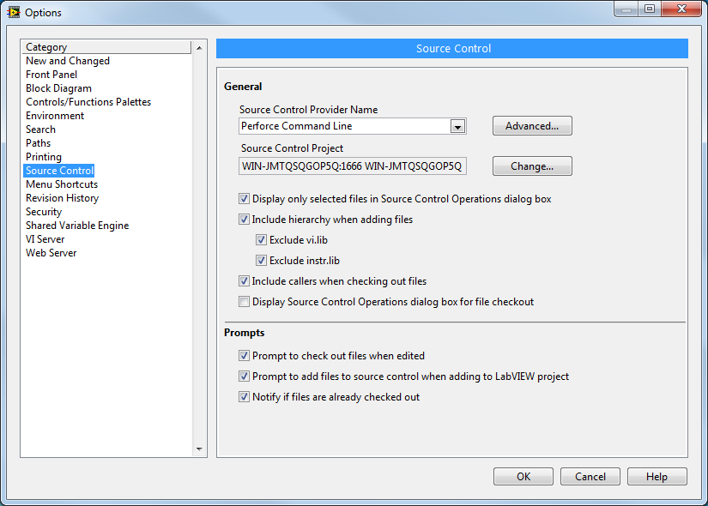
Configuring SCC with LabVIEW
Recommended Settings
Include hierarchy when adding files
Adding a top-level VI to SCC includes dependencies
Exclude vi.lib
Adding a top-level VI to SCC does not include dependencies from vi.lib
Tools » Options » Source Control
Notes:
If you are using a SCC provider that integrates into the LabVIEW Environment, you can configure settings that specify which files are added to your repository.
I recommend that you choose to include hierarchy when adding files, which means that if you add a top-level VI to SCC, then all of it’s dependencies will also be added to SCC. However, you do not want to add base LabVIEW functions to SCC so choose to exclude vi.lib and instr.lib from the files to be added because you likely won’t be making changes to the source code of those VIs.
[transition] Now I’m going to show you how to configure SCC using Subversion with the TortoiseSVN client. This is a free and Open Source option for SCC, and it’s one that I’ve found to be quite effective.

Slide 10
Demo
Configuring SVN Source Code Control with LabVIEW

Slide 11
Considerations When Storing VIs Under SCC
When you edit a VI, LabVIEW recompiles the VI code. LabVIEW may also recompile the callers of that VI to optimize code.
Contents of a VI
Front Panel
Block Diagram
Graphical Source Code
Connector Pane
Icon
Compiled Code
Inplaceness Info
Compiled Code
Notes:
Now that you’ve seen SCC in action, let’s talk about an important consideration.
LabVIEW is a compiled language, just like C for example. However, unlike C, a single VI file stores both graphical source code as well as compiled code. If you are familiar with C, then you know that the source code, a .c file, is separated from compiled code, a .obj file. In LabVIEW, by default, a VI contains both the source and compiled code.
[transition] This is important when we talk about source code control, because anytime you edit a VI, LabVIEW recompiles the source code.

Slide 12
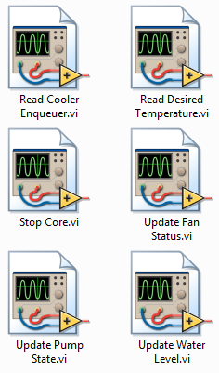
Considerations When Storing VIs Under SCC
When you edit a VI, LabVIEW recompiles the VI code. LabVIEW may also recompile the callers of that VI to optimize code.
*
NOT modified by developer, but code was recompiled
Calling VI
Calling VIs that have not been modified by a programmer may indicate that they have been modified, and therefore require resubmitting to SCC.
*
SubVIs
modified by developer
Notes:
Let’s say you have a calling VI that calls two subVIs. If you modify the source code of one of the subVIs, then it’s possible that the calling VI may be recompiled to optimize code even though it’s graphical source code hasn’t changed.
Even if you did not directly modify the graphical source code of the calling VI, it may still show a dirty dot because it’s compiled code has been updated. Since a VI contains both source and compiled code, the file is considered to be modified, and you have to resubmit the caller to SCC.
[transition] SCC is designed to track modifications to source code, so if only the compiled code has changed, it’s not desirable to have to resubmit. Luckily, there is a way we can avoid this.

Slide 13
Considerations When Storing VIs Under SCC
Eliminate the need to re-save and re-submit files to source code control unless the graphical source code has been changed by the developer
Contents of a VI
Separate .viobj file
Front Panel
Block Diagram
Compiled Code
Inplaceness Info
Connector Pane
Icon
Contains compiled code
Limited to graphical source code
Notes:
For a particular VI, you can choose to separate the graphical source code of the VI from the compiled code of the VI. Parts of the VI that are compiled are housed in a .viobj file. This removes the issue where modifying a subVI modifies the calling VI, because the compiled code is kept separate.
Choosing whether or not to separate compiled code from a VI is a setting that is unique to each individual VI. It can be set for a particular VI via VI Properties. You can also choose to have the setting automatically applied to new VIs that you create, or apply the setting to all VIs in a project.
[transition] You might be wondering, why not make life easy and separate compiled code from all my VIs?

Slide 14
Deciding When to Separate Compiled Code from VIs
Consider separating compiled code to:
Simplify source code control
Prepare VIs under SCC to be upgraded to a new version of LabVIEW
Improve load time of VIs
Do not separate compiled code:
If you intend to run the VI using the LabVIEW Run-Time Engine. In this case, consider building a source distribution instead
Notes:
There are several situations when separating compiled code from a VI is beneficial. We’ve seen that it can be useful to simplify SCC. It’s also handy if you want to upgrade a set of VIs under SCC to be upgraded to a new version of LabVIEW, as this results in the code being recompiled. VIs that have their compiled code separated are loaded faster. However, if you want to run a VI using the LabVIEW run-time engine, then you cannot separate the compiled code from the VI.*
[transition] We’ve learned that SCC can help us manage code revisions. What if we want to examine differences between two versions of a VI, or merge two versions of a VI together?
*Question: What’s with the run-time engine limitation?
Answer: If you're running the VIs during dev on a machine that has the LabVIEW environment installed, everything should work fine because the dev environment can access the VI Object cache, where the separated compiled code is stored. If you take those VIs and build them into an EXE or a shared library with the app builder, and then run them with the run-time engine, they won't work if you've separated compiled code because the run-time engine cannot access the VI Object Cache.

Slide 15
Graphical Diff and Merge Utilities
Since the source code for a VI is binary, specific comparison and merge utilities must be used.
Diff and Merge Utilities LVCompare.exe LVMerge.exe
Call directly from LabVIEW Development Environment
Call directly from SCC utility
SCC provider must support Microsoft API
Must configure for command-line integration
Notes:
Since LabVIEW’s graphical source code is a binary file, you can’t use traditional diff and merge utilities that are often built into SCC providers like Tortoise SVN. However, LabVIEW has built tools that make it possible to diff and merge graphical code and it’s possible to configure your SCC tools to use these specialized functions. If your SCC provider supports the Microsoft API, such as Perforce, you can use these tools normally from the LabVIEW development environment. If you’re using a provider like TortoiseSVN, you will have to take additional steps to configure it for command-line integration.
[transition] You may be familiar with the LabVIEW diff tool, LVCompare.exe.

Slide 16
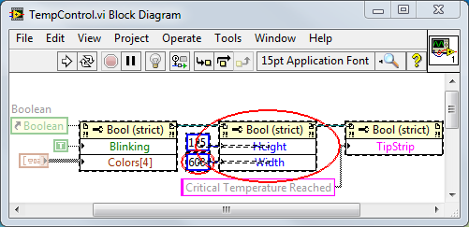
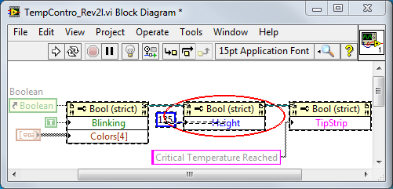
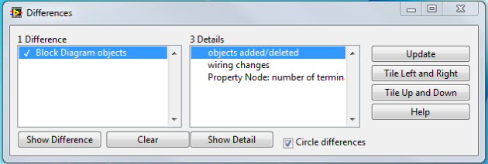
Graphical Differencing
Notes:
The diff tool highlights changes made on both the block diagram and the front panel. In this example, you can see that while Width is specified in one version of the VI, it is not specified in the update.
[transition] A similar tool can be used to merge multiple versions of a VI.

Slide 17
Graphical Merge
Simplify your development cycle by using Graphical Merge to automate code recombination.
Use this tool when modifications to a base VI are made by multiple individuals and saved separately.
Notes:
If multiple developers are working on a VI and they would like to merge a superset of their modifications, this is possible using the LVMerge.exe tool.
[transition] Let’s take a look at how to configure these tools using TortoiseSVN.

Slide 18
Demo
Using Graphical Diff with SVN

Slide 19
Group Development Recommendations
Use Source Code Control
Document changes at each submission
Use VI Compare to assess changes
Use VI Merge to reconcile code contributions
Notes:
There are many benefits of using SCC, and it is an industry standard for any modern software development team. Using SCC allows developers to carefully track and document changes to their code base. Additional tools simplify the diffing and merging of tools.
[transition] When developing a large application, it may be necessary to leverage other code libraries that have been developed by other teams or organization.

